Slide 1
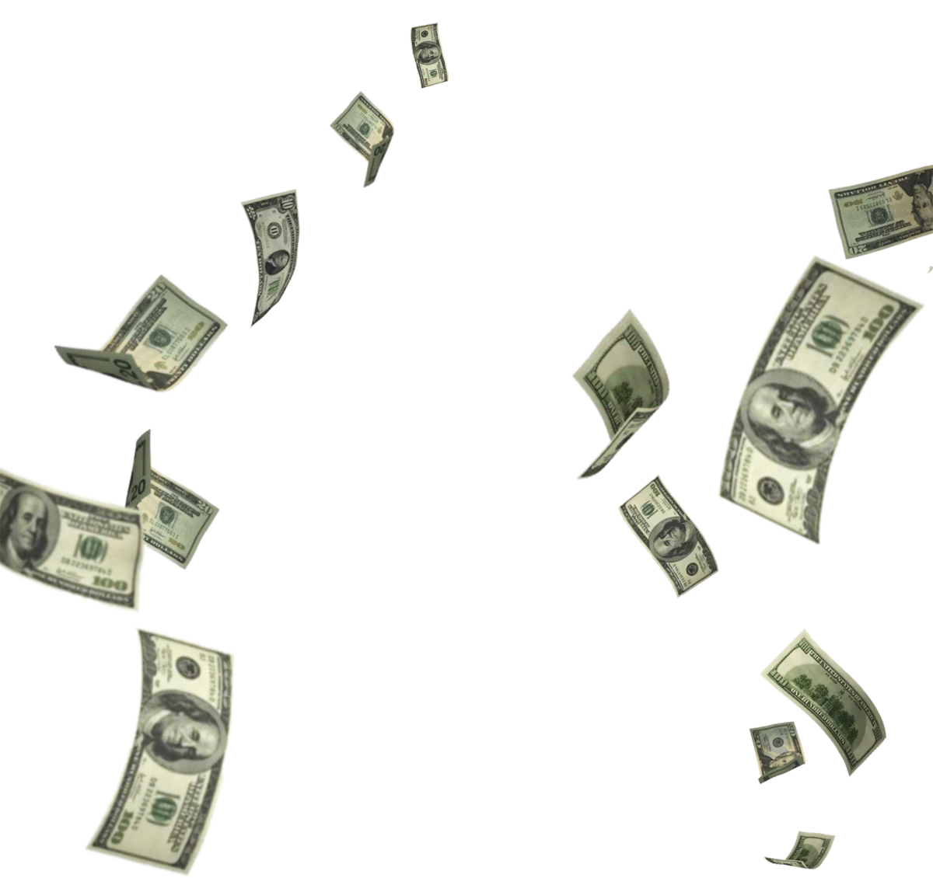
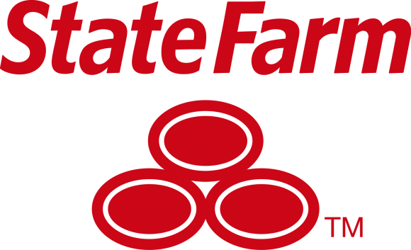
Stay Safe, Stay Healthy, Save Money!
Stay Safe, Stay Healthy, Save Money!
Jesus T. Patino III, Peyton Thibodeaux, Sri Akash Balu, Dhruva Malik

Slide 2
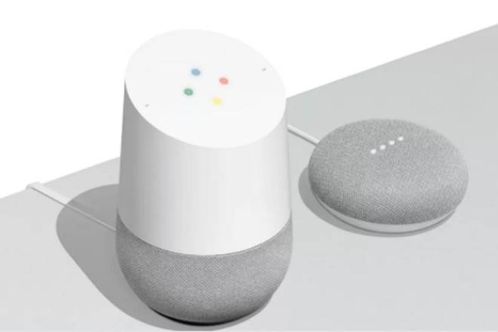

Homeowner’s insurance

Slide 3
System used
Used an arbitrary point system based on the consideration of 9 main variables
Final calculation will give a discount from 5% to 30% (the same spread as the drive safe and save)
Very granular calculations allow a large range of options

Slide 4
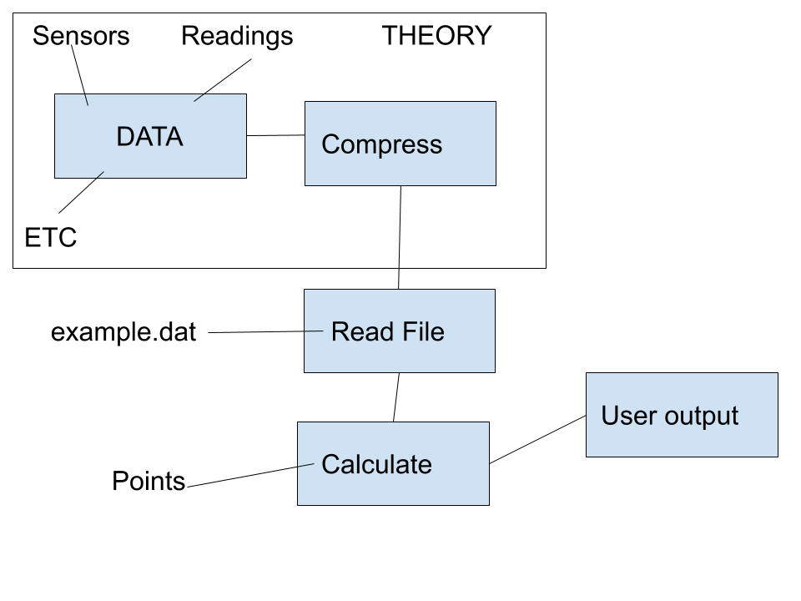
Design Flow

Slide 5
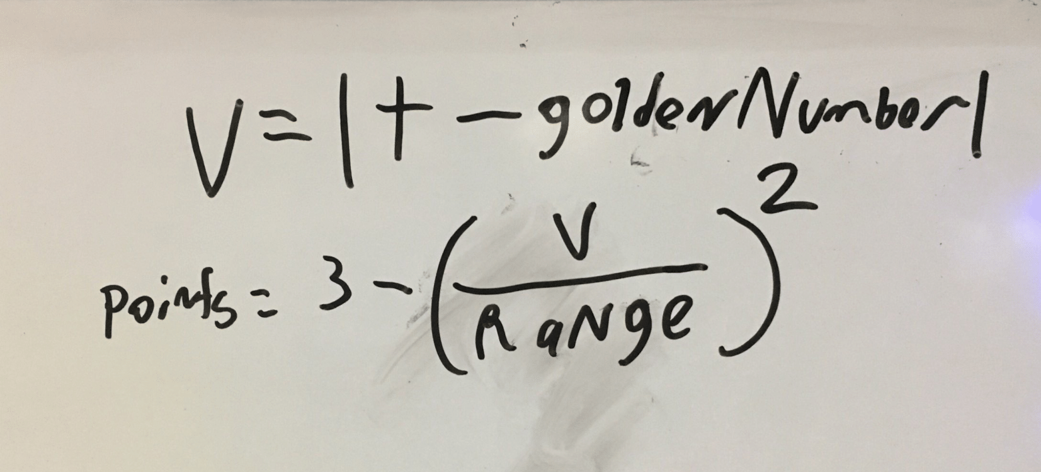
Golden Ratio Function
Larger range means larger “goldie locks area”
“Golden Number” should be in the middle of the acceptable range
Allowed for granular calculations

Slide 6
Variables
Variables are submitted chronologically, and whether it is day or night is accounted for
A water heater variable is used in calculations if the owner has a smart sensor
Pieces of a security system are accounted for
If doors or windows are opened while no one is home is accounted for
Water usage is monitored and if no one is home it is reported
If nest data (or similar) is deleted it is accounted for
Emergency situations are counted

Slide 7
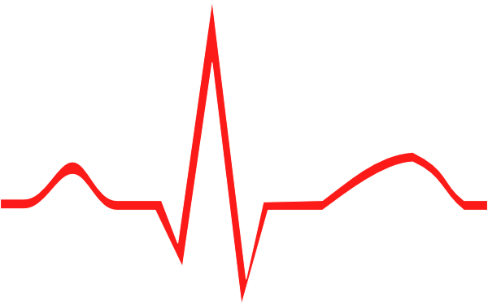
Life Insurance

Slide 8
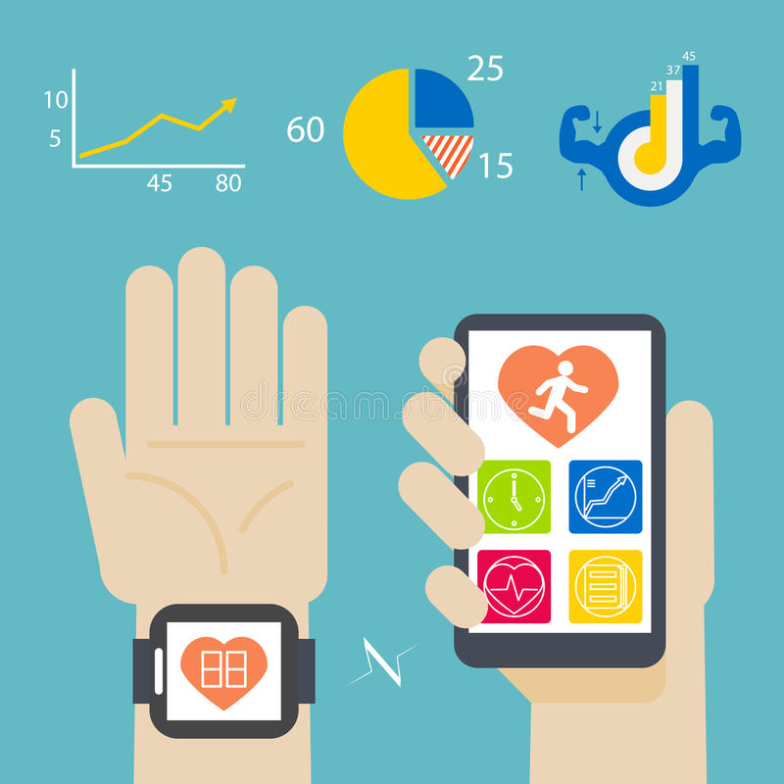
DAQ
What information can we collect from a smartwatch that can help State Farm save?

Slide 9
Variables
Hours of sleep ~less cumulative sleep == less health benefits
Resting & Exercising Heart Rate ~ the better it is, the less everyone has to worry about heart diseases or complications
Exercise ~ “at least 30 minutes a day” (CDC recommendation )
https://www.cdc.gov/physicalactivity/basics/adults/index.htm
Bed Rest ~ If the client listens to health care professionals then they should also be entitled to the discounts

Slide 10
Simple Flow Of Program (How?)
DAQ
-Sleep
-Resting HR
-Exercising HR
-SBP/DBP
-Exercise
-BedRest
Program Execution
Advice for smartwatch user to encourage less risk and more savings
In
Out
Checks if conditions are met for optimal savings
Like HomeOwners Insurance discounts range from 5-30%
Savings for smartwatch user based on behavior
(.dat file gathered from smart watch)

Slide 11

Why?
Why a .dat file?
The ‘.dat’ file is an example of data we could receive from the smart devices that most patients probably own.
Why Bed Rest as a variable? Many medical professionals will tell you that a lot of injuries get worse because the patient does not listen to the physician.
“Points” represent savings, and our clients’ savings mean less risk for State Farm to undertake.

Slide 12
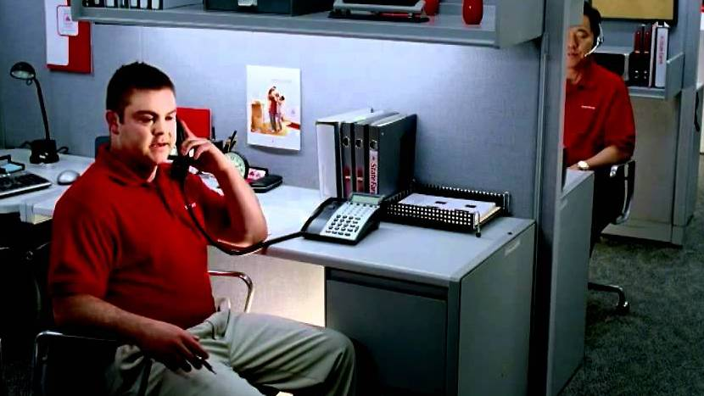
Any Questions?
It’s Jake,... From State Farm!!!

